Slide 1



APEX INSTITUTE OF TECHNOLOGY
DEPARTMENT OF COMPUTER SCIENCE & ENGINEERING
Database Management System (22CSH-243)
Faculty: Ms. Shaveta Jain (13464)
NORMALIZATION(2NF & 3NF
DISCOVER . LEARN . EMPOWER

Slide 2
DBMS: Course Objectives
COURSE OBJECTIVES
The Course aims to:
Understand database system concepts and design databases for different applications and to acquire the knowledge on DBMS and RDBMS.
Implement and understand different types of DDL, DML and DCL statements.
Understand transaction concepts related to databases and recovery/backup techniques required for the proper storage of data.

Slide 3
COURSE OUTCOMES
On completion of this course, the students shall be able to:-
CO3 | Apply relational algebra and relational calculus to query the database of organization

Slide 4
Outline
Second Normal Form (2NF)
Normalizing into 2NF
Third Normal Form (3NF)
Normalizing into 3NF
General Normal Form Definitions
Chapter 10-<number>

Slide 5
Second Normal Form (2NF)
Uses the concepts of FDs, Primary key
Definitions:
Prime attribute - Attribute that is member of the primary key K
Full functional dependency - a FD Y -> Z where removal of any attribute from Y means the FD does not hold any more
Examples:
{SSN, PNUMBER} -> HOURS is a Full FD since neither SSN -> HOURS nor PNUMBER -> HOURS hold
{SSN, PNUMBER} -> ENAME is not a Full FD (it is called a Partial Dependency ) since SSN -> ENAME also holds
Chapter 10-<number>

Slide 6
Second Normal Form (2NF)
A relation schema R is in Second Normal Form (2NF) if:-
  It is in 1NF, and
  Every Non-prime attribute A in R is Fully Functionally Dependent on the Primary Key
  (i.e There should be no Partial Dependency)
R can be decomposed into 2NF relations via the process of 2NF normalization
Chapter 10-<number>

Slide 7
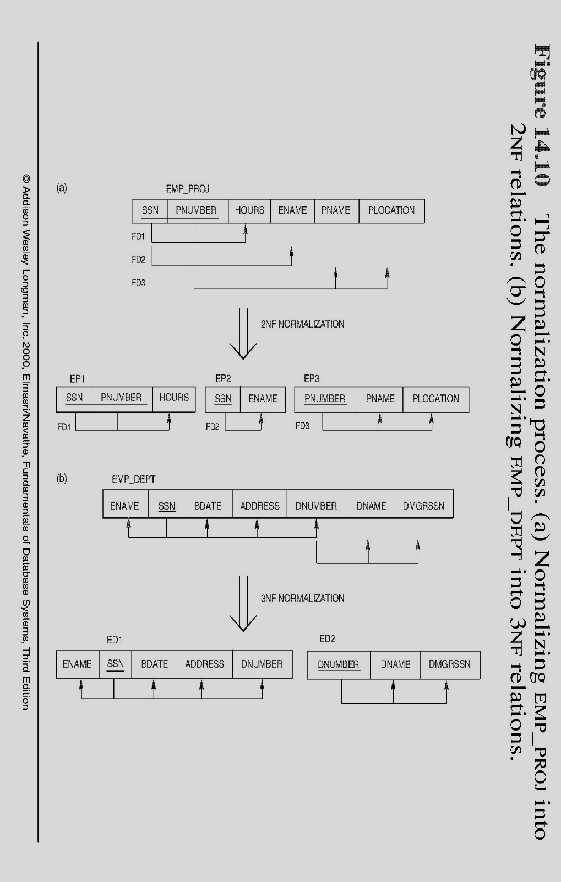
Normalizing into 2NF
The Normalization process: a) Normalizing EMP_PROJ into 2NF relations
Note: The above figure is now called Figure 10.10 in Edition 4
Chapter 10-<number>

Slide 8
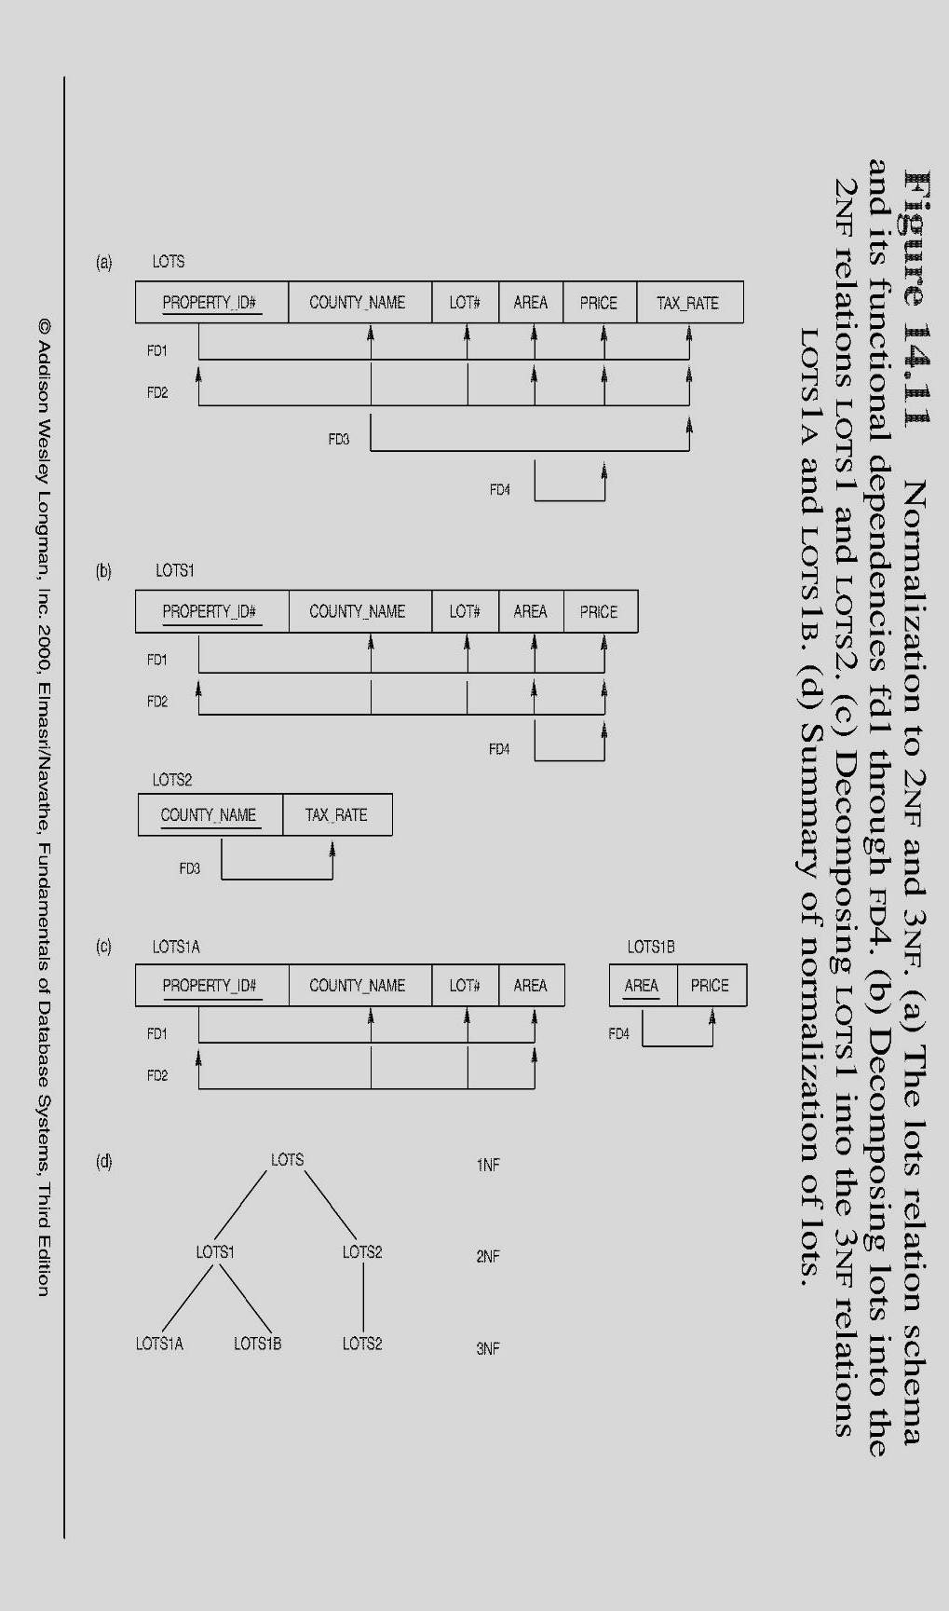
Normalization into 2NF
The Lots relation schema and its Functional Dependencies fd1 through fd4
Decomposing lots into the 2NF relations LOTS1 and LOTS2
Note: The above figure is now called Figure 10.11 in Edition 4
Chapter 10-<number>

Slide 9
Third Normal Form (3NF)
Definition:
Transitive functional dependency - a FD X -> Z that can be derived from two FDs X -> Y and Y -> Z
Examples:
SSN -> DMGRSSN is a transitive FD since
SSN -> DNUMBER and DNUMBER -> DMGRSSN hold
SSN -> ENAME is non-transitive since there is no set of attributes X where SSN -> X and X -> ENAME
Chapter 10-<number>

Slide 10
Third Normal Form (3NF)
A relation schema R is in Third Normal Form (3NF):-
  If it is in 2NF and
  No Non-prime attribute A in R is Transitively Dependent on the primary key
  (i.e. There should be no Transitive Dependency)
R can be decomposed into 3NF relations via the process of 3NF normalization
Chapter 10-<number>

Slide 11
Third Normal Form (3NF)
NOTE:
In X -> Y and Y -> Z, with X as the primary key, we consider this a problem only if Y is not a candidate key.
When Y is a candidate key, there is no problem with the transitive dependency .
E.g., Consider EMP (SSN, Emp#, Salary ).
Here, SSN -> Emp# -> Salary and Emp# is a candidate key.
Chapter 10-<number>

Slide 12
Normalizing into 3NF
The Normalization process: b) Normalizing EMP_DEPT into 3NF relations
Note: The above figure is now called Figure 10.10 in Edition 4
Chapter 10-<number>

Slide 13
Normalization into 3NF
c) Decomposing LOTS1 into 3NF relations LOTS1A and LOTS1B
d) Summary of Normalization of Lots
Note: The above figure is now called Figure 10.11 in Edition 4
Chapter 10-<number>

Slide 14
General Normal Form Definitions (For Multiple Keys)
The above definitions consider the primary key only
The following more general definitions take into account relations with multiple candidate keys
A relation schema R is in second normal form (2NF) if every non-prime attribute A in R is fully functionally dependent on every key of R
Chapter 10-<number>

Slide 15
General Normal Form Definitions
A relation schema R is in Third Normal Norm (3NF) if whenever a FD X -> A holds in R, then either:
(a) X is a Superkey of R, or
(b) A is a Prime Attribute of R
NOTE:
Boyce-Codd Formal Form (BCNF) disallows condition (b) above
Chapter 10-<number>

Slide 16
References
RamezElmasri and Shamkant B. Navathe, “Fundamentals of Database System”, The Benjamin / Cummings Publishing Co.
Korth and Silberschatz Abraham, “Database System Concepts”, McGraw Hall.
C.J.Date, “An Introduction to Database Systems”, Addison Wesley.
Thomas M. Connolly, Carolyn & E. Begg, “Database Systems: A Practical Approach to Design, Implementation and Management”, 5/E, University of Paisley, Addison-Wesley.

Slide 17

THANK YOU
For queries
Email: shaveta.e13464@cumail.in

